Slide 1

Introduction to BEAST2
Nicola F. Müller
e-mail: nicola.felix.mueller@gmail.com

Slide 14
Our data: We know who was infected with which pathogen and sequence and when they were sampled

Slide 15
Phylogenetics allows us to infer the shared ancestral history of the different pathogens

Slide 16
Phylogenetic trees are formed by population processes and contain information about them
Notes:
5 Minutes

Slide 17
Bayesian phylogenetics allows us to jointly infer the phylogenetic trees, evolutionary and Demographics models
L. Du Plessis, T. Stadler “Getting to the root of epidemic spread with phylodynamic analysis of genomic data” Trends in Microbiology, 2015
Notes:
One way to do so, is what’s called Bayesian phylogenetics.
In Bayesian phylogenetics, we try to infer the phylogenetic tree, how genomes evolve over time, which is this second bit here and how the tree was created.
The tree generating process is some model that describes how the tree came to be.
The three terms in the back are priors that allow us to input our prior belief in parameters, for example what is a priori by expectation of the rate of evolution of a pathogen.
Back to tree priors

Slide 18
Bayesian phylogenetics allows us to jointly infer the phylogenetic trees, evolutionary and Demographics models
Tree generating models
Model of sequence evolution
L. Du Plessis, T. Stadler “Getting to the root of epidemic spread with phylodynamic analysis of genomic data” Trends in Microbiology, 2015
Notes:
One way to do so, is what’s called Bayesian phylogenetics.
In Bayesian phylogenetics, we try to infer the phylogenetic tree, how genomes evolve over time, which is this second bit here and how the tree was created.
The tree generating process is some model that describes how the tree came to be.
The three terms in the back are priors that allow us to input our prior belief in parameters, for example what is a priori by expectation of the rate of evolution of a pathogen.
Back to tree priors

Slide 19
Bayesian phylogenetics allows us to jointly infer the phylogenetic trees, evolutionary and Demographics models
Tree generating models
Model of sequence evolution
L. Du Plessis, T. Stadler “Getting to the root of epidemic spread with phylodynamic analysis of genomic data” Trends in Microbiology, 2015
Notes:
One way to do so, is what’s called Bayesian phylogenetics.
In Bayesian phylogenetics, we try to infer the phylogenetic tree, how genomes evolve over time, which is this second bit here and how the tree was created.
The tree generating process is some model that describes how the tree came to be.
The three terms in the back are priors that allow us to input our prior belief in parameters, for example what is a priori by expectation of the rate of evolution of a pathogen.
Back to tree priors

Slide 20
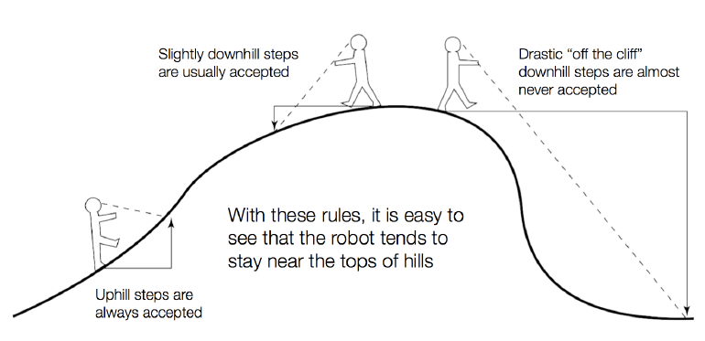
Exploring the posterior probability distribution using Markov chain Monte Carlo (MCMC)
Slide from Paul Lewis

Slide 21
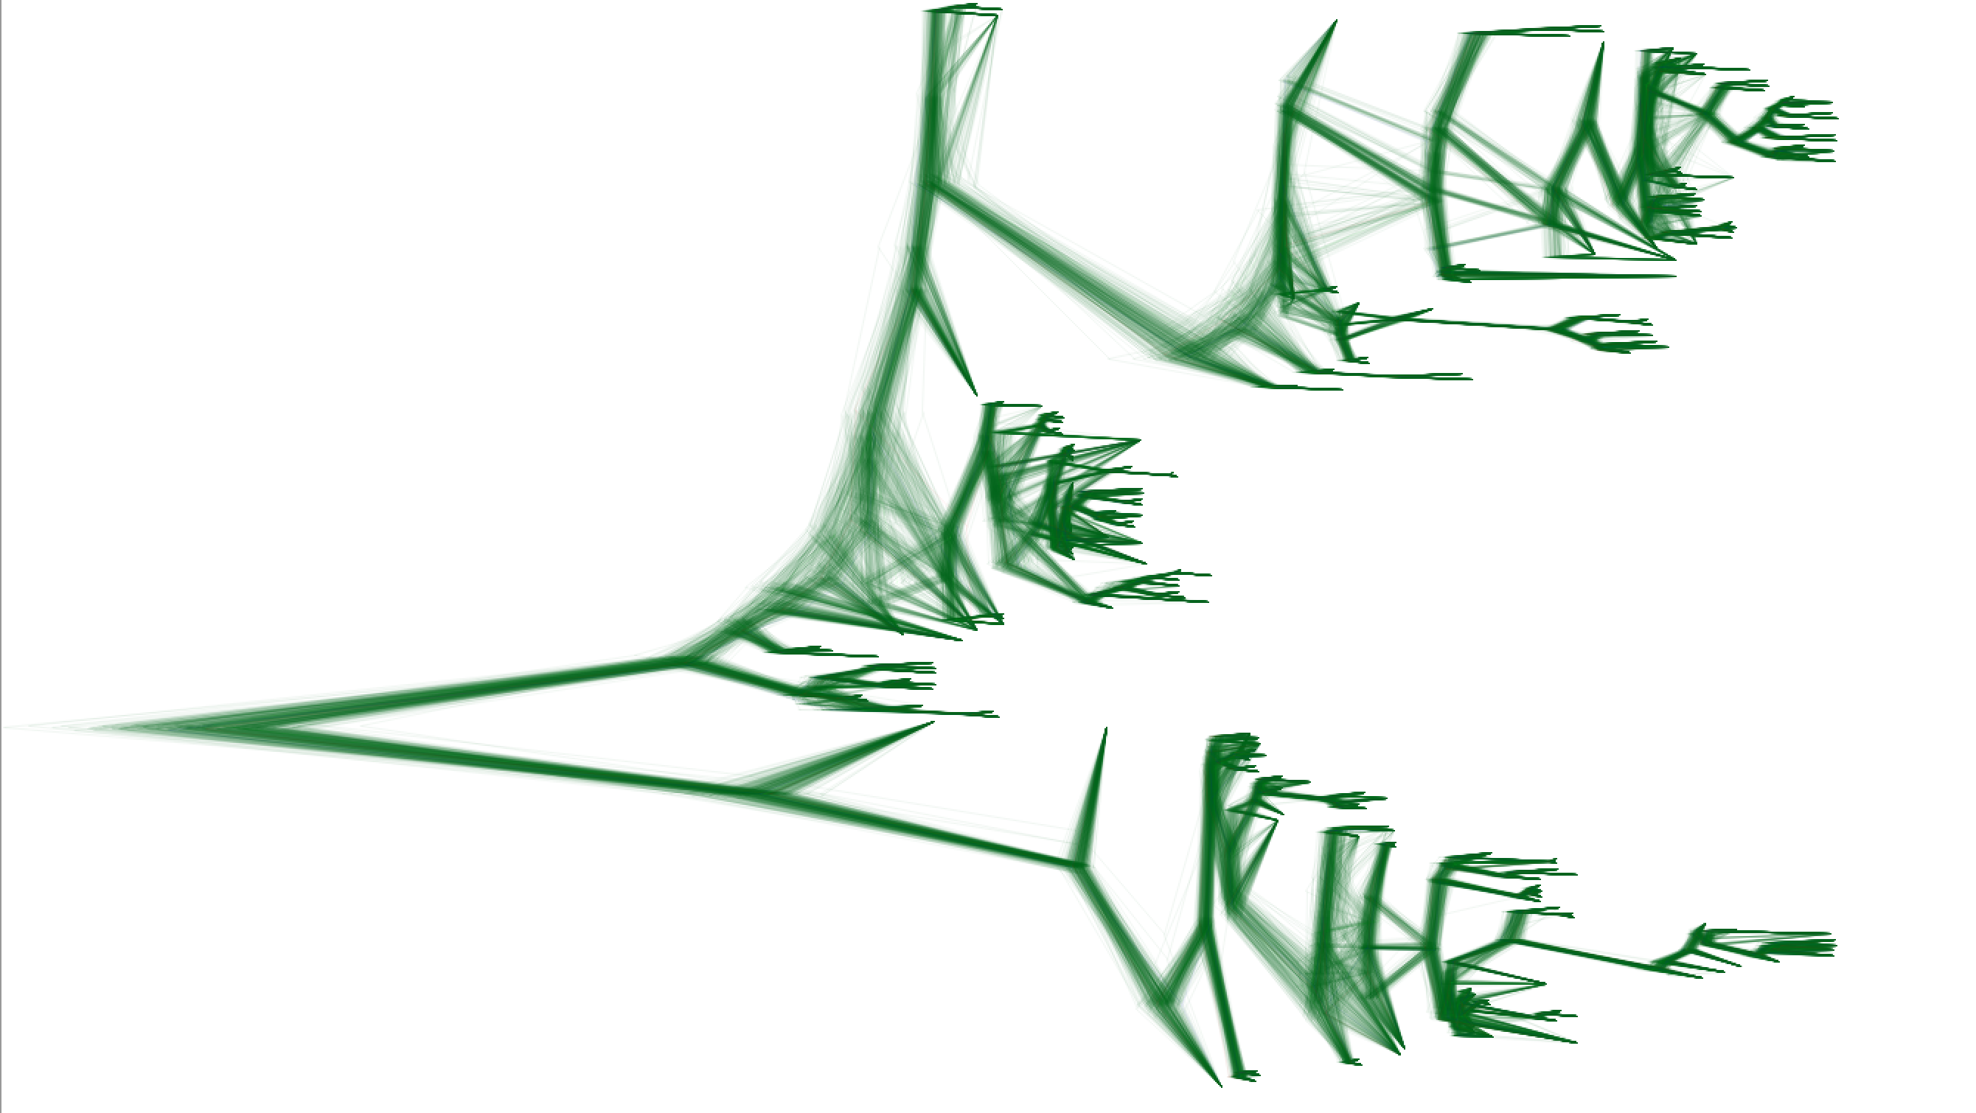
The results of the

Slide 22




The general workflow works as follows
Analyze your results
Setting up an xml in BEAUti
Run the xml using BEAST
*.log files
*.trees files

Slide 23
The general workflow works as follows
Analyze your results
Setting up an xml in BEAUti
Run the xml using BEAST
*.log files
*.trees files

Slide 24
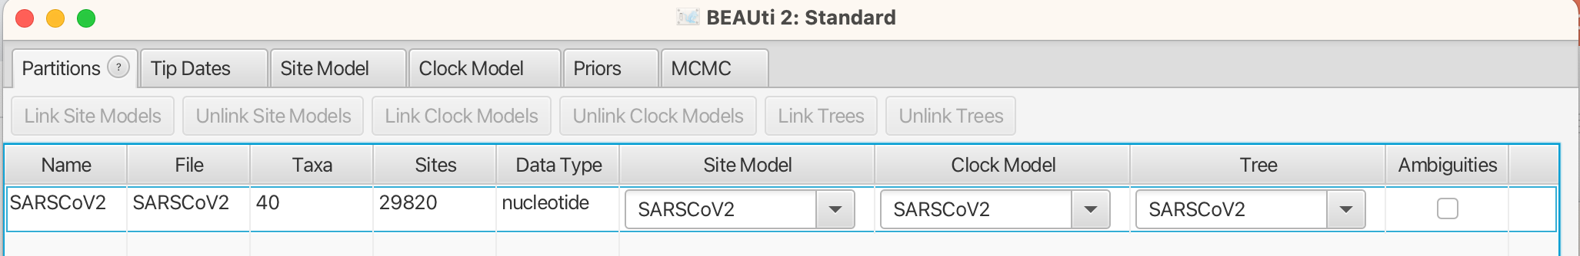
Alignments are loaded into the Partitions tab

Slide 25
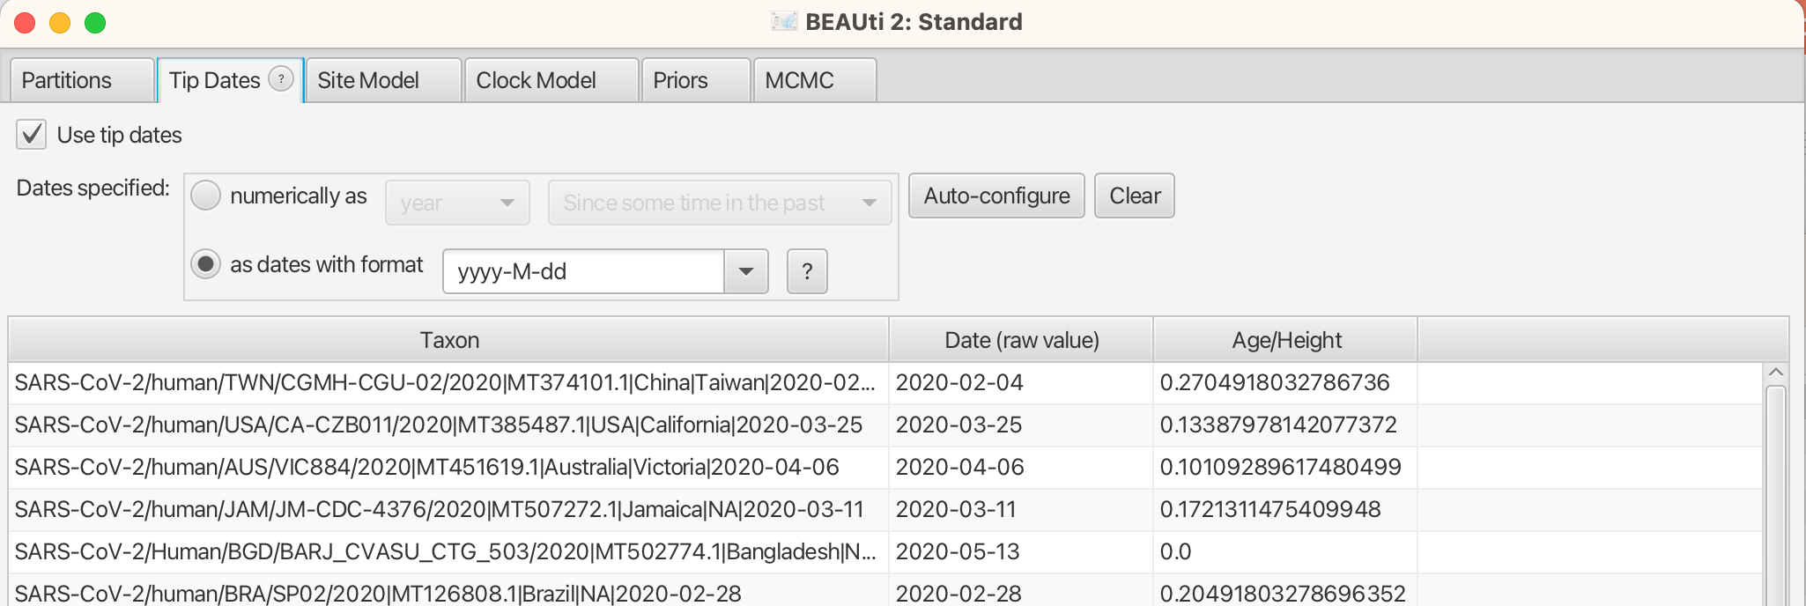
In the Tip Dates tab, the sampling times are specified

Slide 26
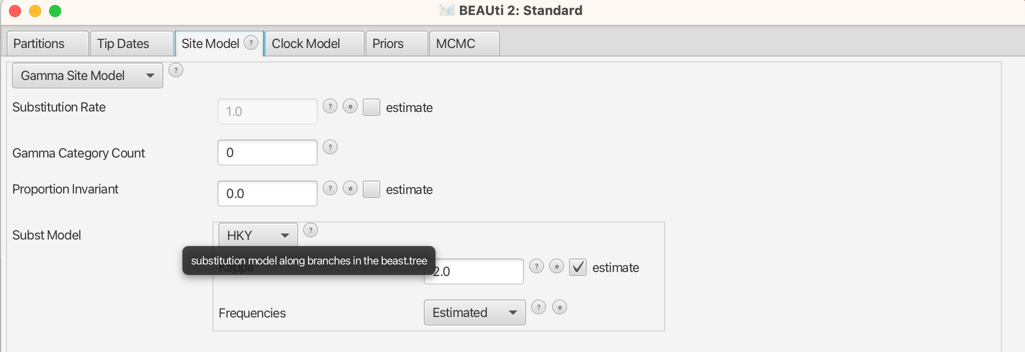
In the Site Model tab, we can choose the model of sequence evolution

Slide 27
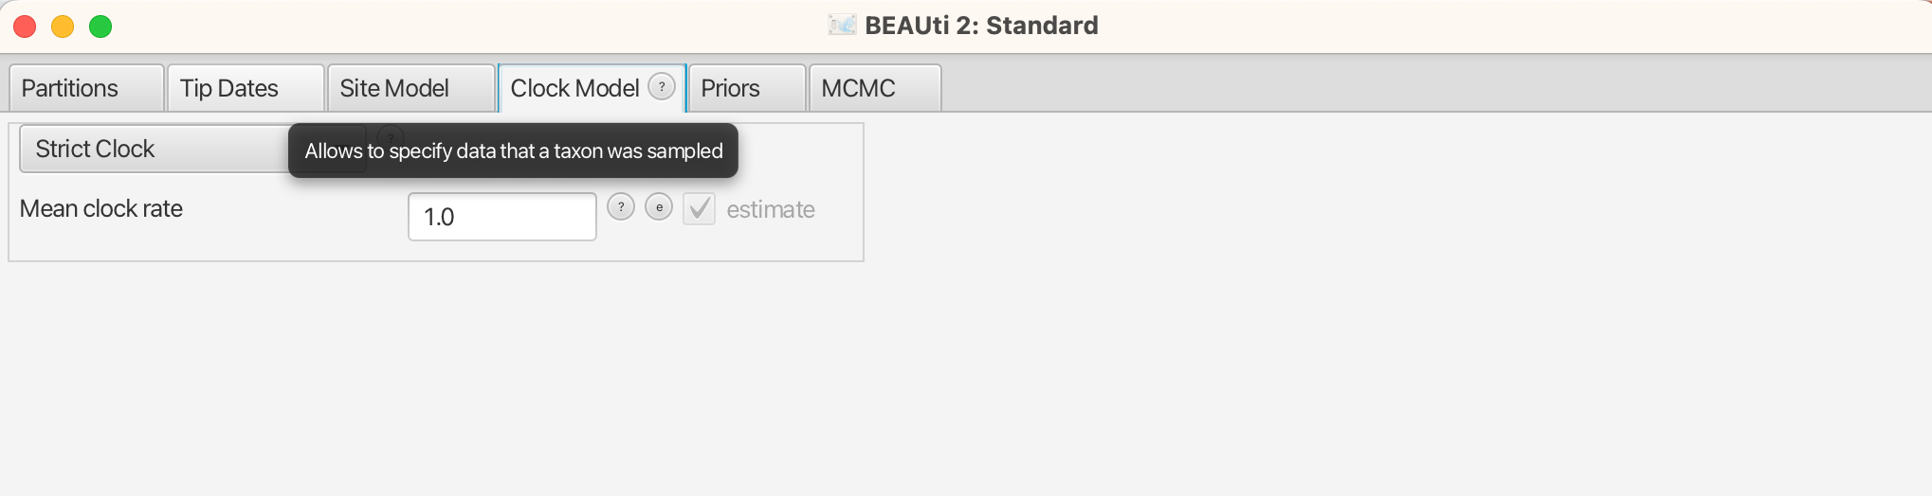
In the Clock Model tab, we can choose the model of how sequences evolve over time

Slide 28
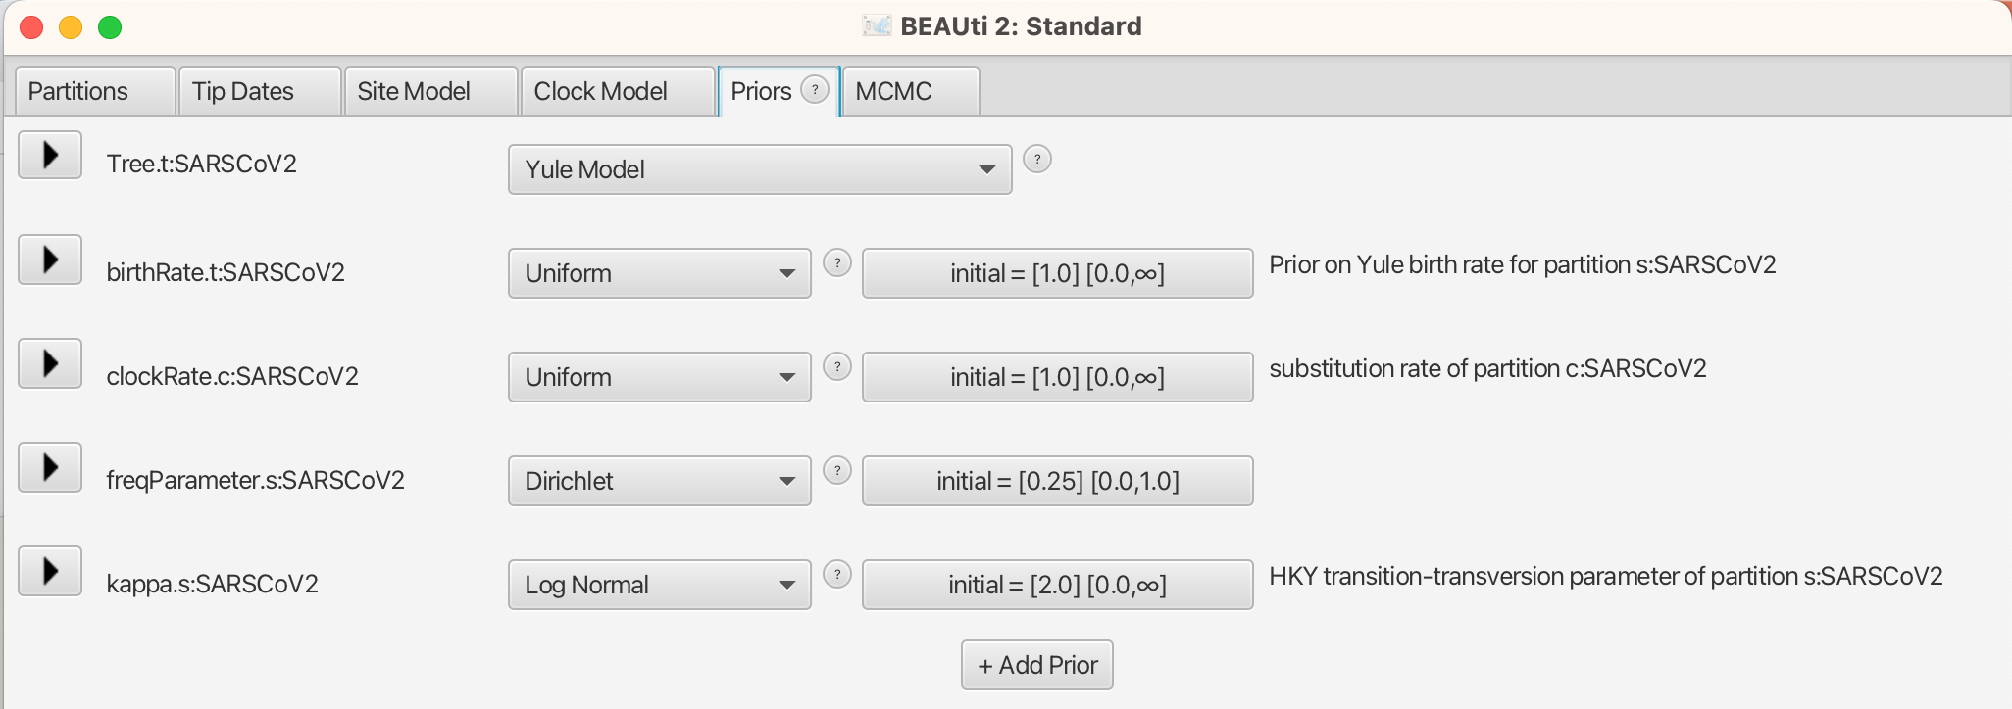
In the Priors tab, we can first set the demographic model

Slide 29
Next, we can specify the prior on the parameters of the demographic model

Slide 30
Next, we can specify the prior on the clock rate

Slide 31
Last, we can specify the prior on site model

Slide 32
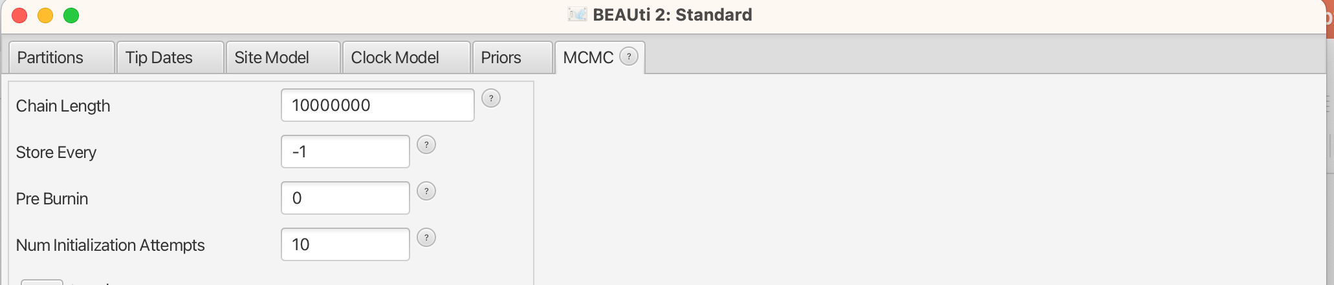
Specifying the settings of the “MCMC robot” happens largely under the hood

Slide 33
Specifying the settings of the “MCMC robot” happens largely under the hood

Slide 34
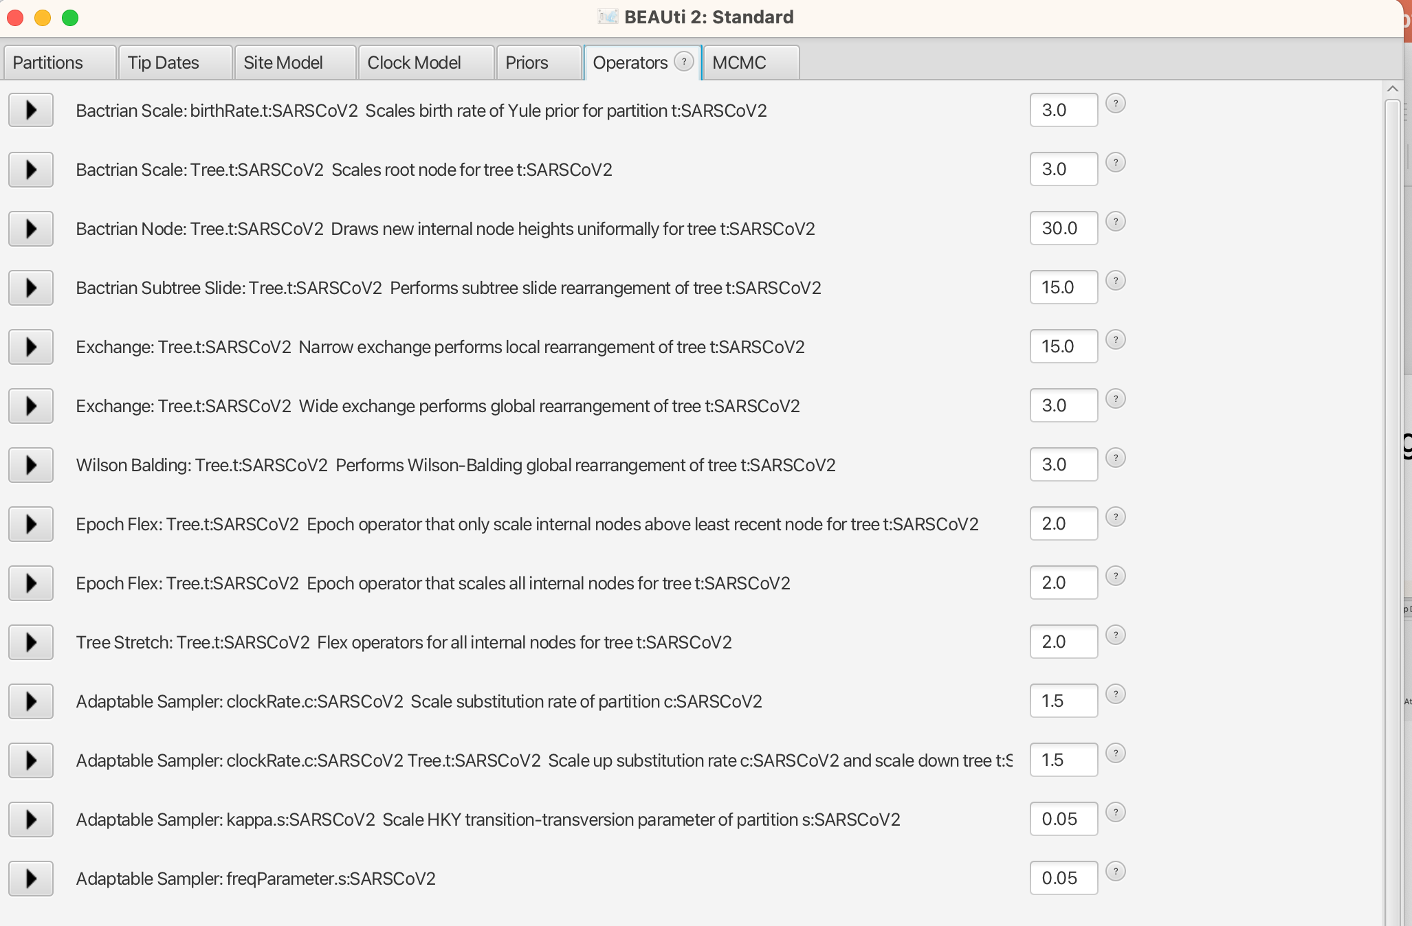
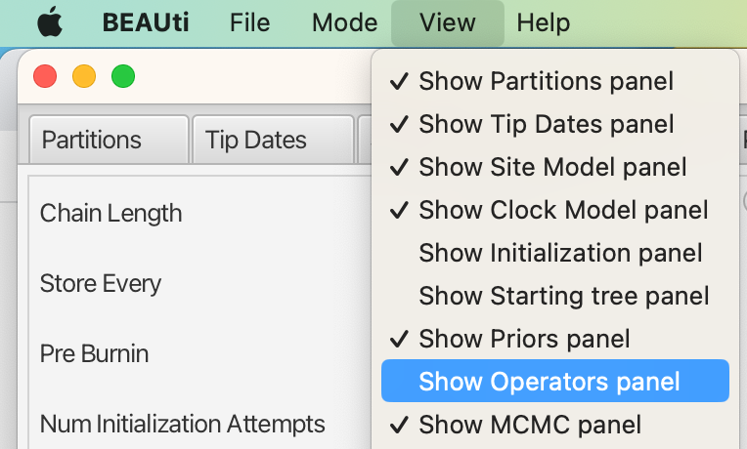
Though these settings can be accessed in the operator panel

Slide 35
The general workflow works as follows
Analyze your results
Setting up an xml in BEAUti
Run the xml using BEAST
*.log files
*.trees files

Slide 36
The general workflow works as follows
Analyze your results
Setting up an xml in BEAUti
Run the xml using BEAST
*.log files
*.trees files

